Slide 1
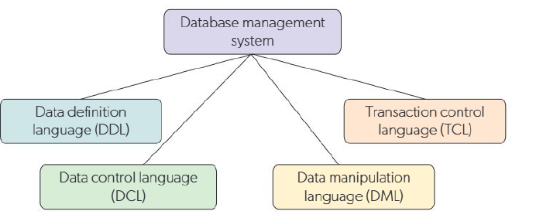
A3.3.1 Outline the difference between data language types within structured query language (SQL)
Database management systems use four different types of language to create databases, manipulate databases, and enable safe interaction with the database.The database management system can be thought of as an umbrella for each of the languages.

Slide 2
Command | Purpose
CREATE | Creates database objects (e.g., tables, views, schemas).
ALTER | Modifies the structure of existing database objects.
DROP | Deletes database objects from the structure.
TRUNCATE | Removes all records from a table without deleting the table itself.
RENAME | Renames an existing database object.
COMMENT | Adds a descriptive note to the database structure.
Data Definition Language (DDL)
Definition:
DDL is used to create and manage the structure of a database.
It defines the schema, tables, and constraints within the database.
Using DDL statements, you can design the overall structure or outline of the database.

Slide 3
Data Manipulation Language (DML)
Definition:
The Data Manipulation Language (DML) is used to access and modify data stored within a database.
Purpose:
Retrieve data through queries.
Insert, update, or delete records.
Manage data transactions dynamically.
Command | Purpose
SELECT | Retrieves data from the database.
INSERT | Adds new data into a table (entity).
UPDATE | Modifies existing data within a table.
DELETE | Removes records from a table (but not the table itself).
CALL | Executes an SQL operation or stored procedure.
LOCK TABLE | Controls data access to ensure concurrency and data integrity.

Slide 4
Data Control Language (DCL)
Definition:
The Data Control Language (DCL) is used to control access and permissions within a database.
Purpose:
Maintains security and user access control.
Grants or revokes permissions to ensure data protection.
Helps database administrators manage who can view or modify data.
Command | Purpose
GRANT | Provides users with specific access privileges in the database.
REVOKE | Removes previously granted access privileges.

Slide 5
Transaction control language
The transaction control language (TCL) is used to complete the changes
in a database.
Commands in the TCL include the following.
* COMMIT Used to complete queries and save them within the database.
* ROLLBACK Used if there is an issue in an operation to restore the database
back to its last COMMIT statement.

Slide 6
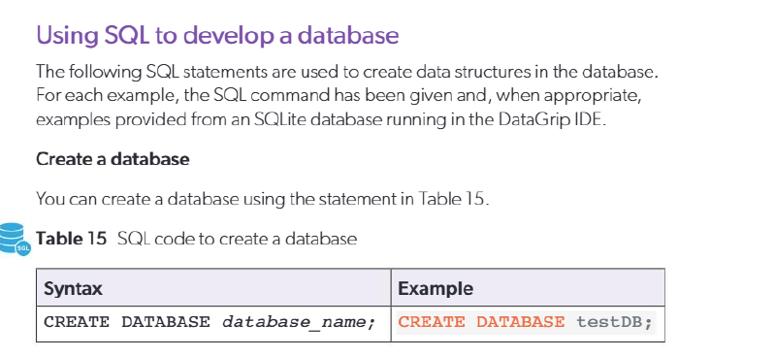

Slide 7
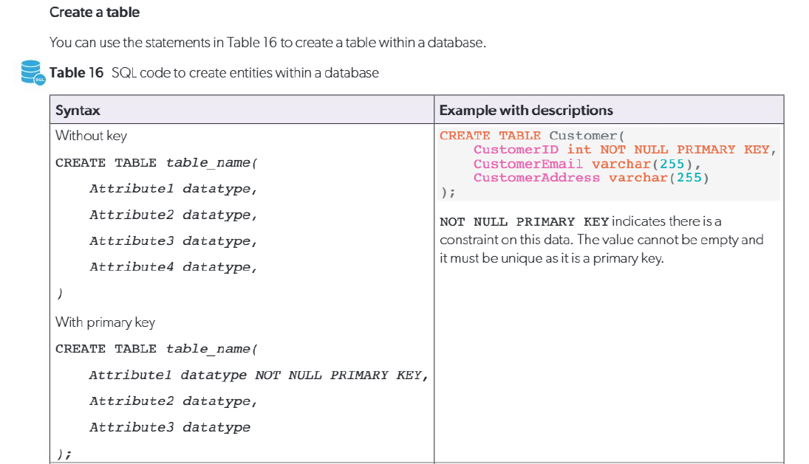

Slide 8
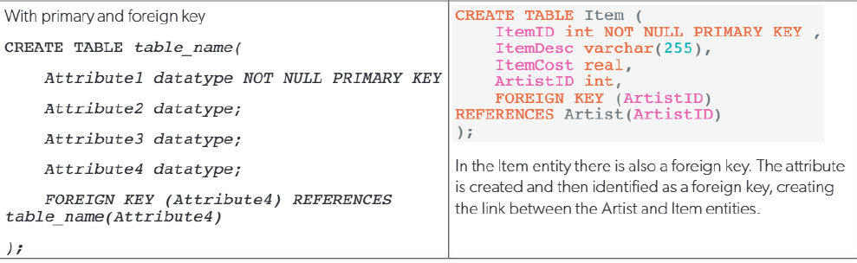

Slide 9
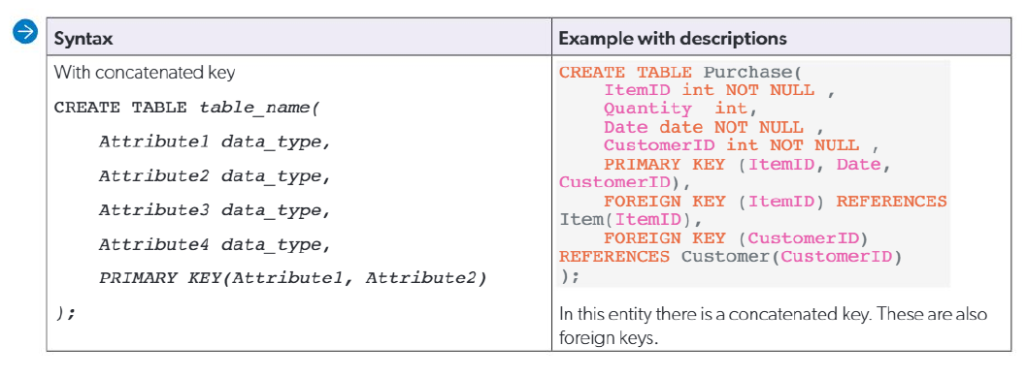

Slide 10
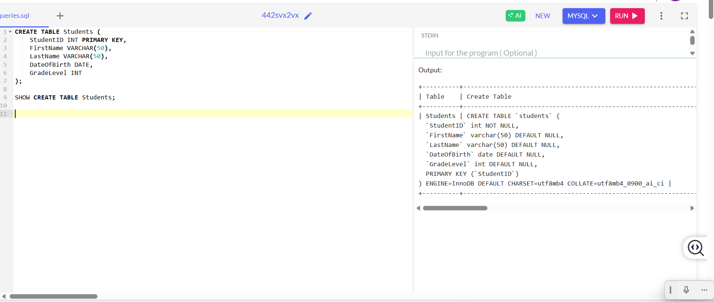

Slide 11
CHALLENGE :
STUDENTS WILL TRY ALL THE EXAMPLES SHARED ON ONECOMPILER.COM
Create a table to display students database

Slide 12
HOMEWORK :
Install Mysql drivers both on device and vscode extension
Create a connection
Try again few examples of table
Students ensure this is mandatory to create tables online

